Slide 1
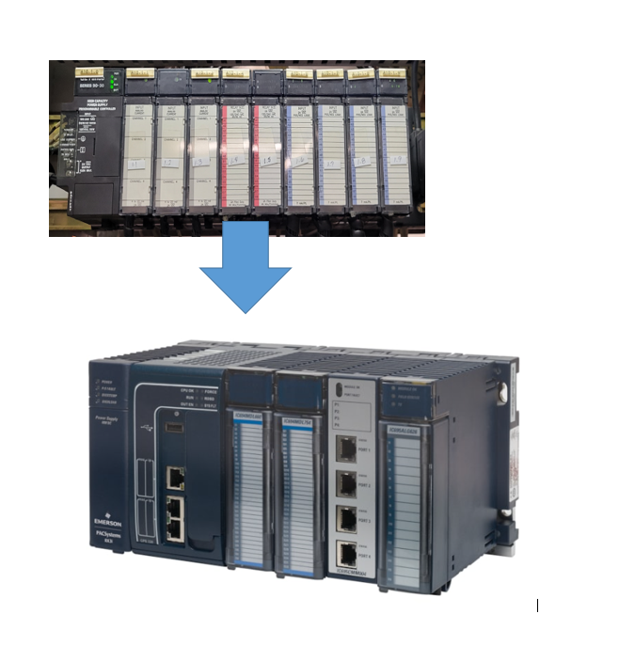
Migrate from GE Fanuc 9030
To the Emerson RX3i

Slide 2
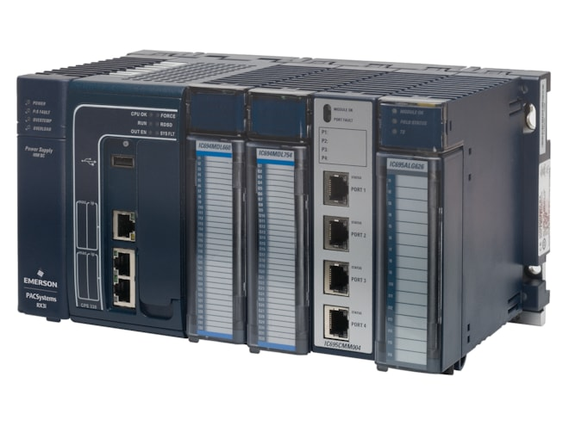
Why should a customer migrate?
Ethernet programming interface standard
Better performance - More processing power
Increased Security. Secure by Design
RX3i is a current manufactured/factory supported (9030 is NOT)
Simple program migration with Conversion process
9030 modules are compatible in RX3i rack
OPC UA server supported

Slide 3
Types of Migration
Basic Migration - Minimal
Comprehensive Project Migration
Base
CPU
Power supply
Reuse all IO modules
IC695LRE001 for serial expansion.
Simplest option
Replace all components
Many IC693 simply have IC694 equivalents
Remote racks could be serial or Profinet
All new control system with no weak points

Slide 4
Potential Challenges we need to be aware of
Remote Racks and the modules they contain
Genius modules
Other Communication Modules
Motion Modules
3rd Party Modules (Horner Electric)
Rack size differences
Project was completed in something other than Machine Edition such as VersaPro, Logic Master, LM90

Slide 5
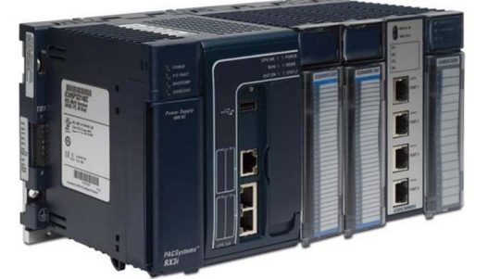
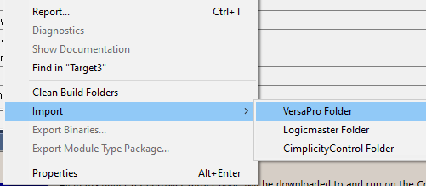
What is the process?
Step 1: Get A Copy of the Project. This will tell us the logic and the Hardware Configuration
Step 2: Open/convert with Machine Edition to see potential challenges
Step 3: Which hardware needs to be quoted? Basic or Comprehensive.
BASIC
*A basic migration should be a rack, CPU and power supply. If there are existing 9030 serial remote racks, IC695LRE001 will be needed.
+Assuming all 9030 modules are working correctly everything else can stay, including 3rd party modules and Genius.
COMPREHENSIVE
*A comprehensive migration replaces all hardware, whether or not it is needed.
Why should a customer reuse ~20 year old wires, module, and technology?
Watch out for :
Genius Blocks
3rd party Modules
Motion
Other Communication modules
If the customer does not have a copy the program will need to be read from the existing PLC using Machine Edition. If programmed before 2004 it is likely in VersaPro or Logic Master. PME cannot “read” but it can convert. Hope they have a copy. To import, they right click target and select “import”

Slide 6
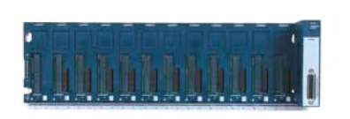
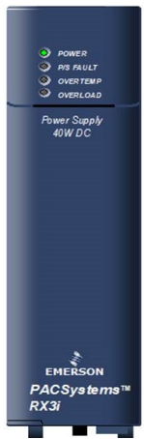
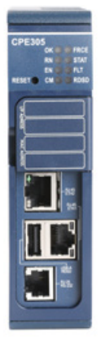

Basic Migration
Rack
The customer wants to do the bare minimum. All modules are fine but it is just time to upgrade.
BASIC Migration required components
Rack (IC695CHS…)
CPU (IC695CPE…)
Power supply (IC695PS…)
IC695LRE001 (only if there are remote serial expansion bases)
Existing 9030 Modules can be installed in the new RX3i base.
Power Supply
CPU
IC695LRE001 is only needed if there are serial expansion racks. Existing 9030 racks can be reused. It is the only module that can go in the final slot of the rack.

Slide 7
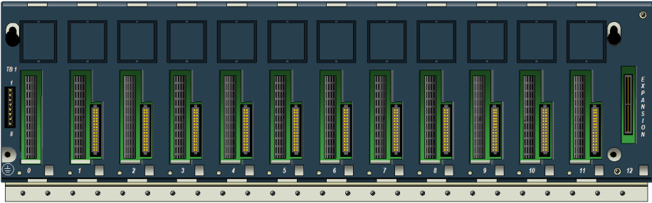
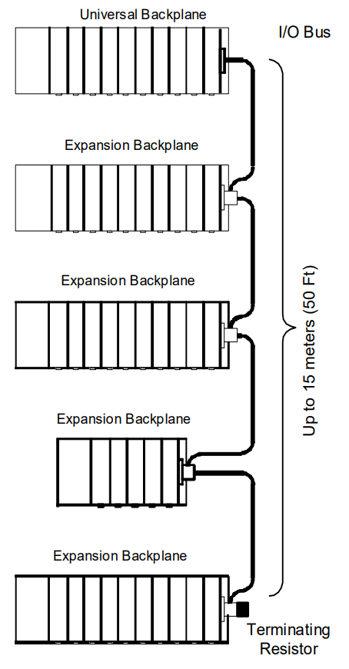
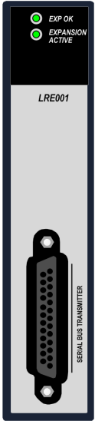
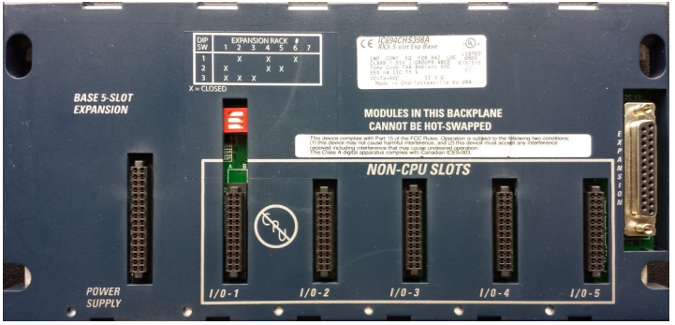

IC695LRE001 = Serial Expansion racks
IC695LRE001 is a Serial Bus Transmitter module. This allows customer to upgrade the main rack to RX3i and leave all 9030 serial remote racks and cabling in place.
Expansion bases will look like this. (Notice there is only the serial bus)
Serial
PCI Bus
Serial
Bus

Slide 8
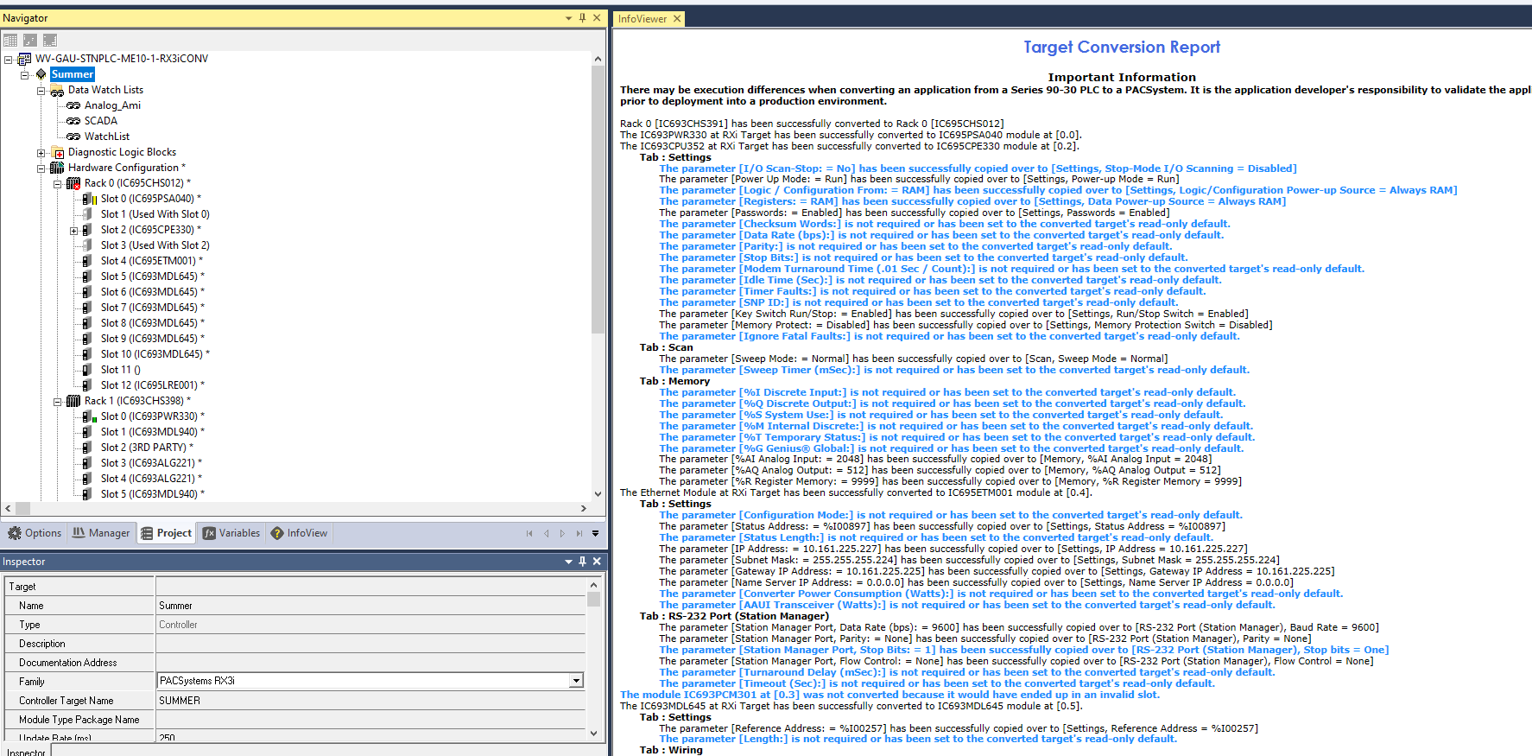
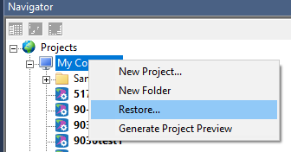
What it looks like to Convert project in PME
Click on target “Summer” in this case. Product family can be changed to PACSystems RX3i using the Inspector window
After the conversion, the main rack (Rack 0) is now RX3i part number with necessary RX3i components in Slot 0-4, and slot 12 for Serial Expansion IC695LRE001. Racks 1-5 are not changed but will still work with old 9030 expansions
Restore the project by right click “My Computer” in PME.
A target conversion report pops up in the main screen and tells us we are successful and what modules we added. They default to CPE330 so it is important to review and change.
This particular project has 3rd party modules. A bare minimal migration will be easiest. If the customer wants to replace all modules with NEW, we are going to have to convert this to all universal bases and Profinet. HE693 modules

Slide 9
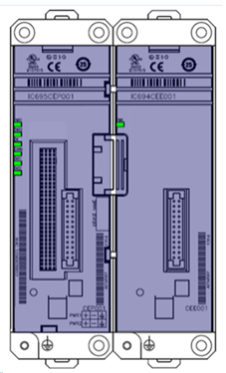
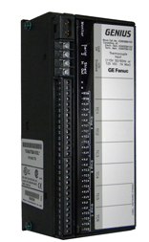
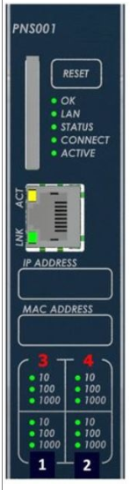
Genius Blocks
IC695CEP001 for one module. Accepts any module. Integrated Profinet scanner. Just run 24VDC to the carrier and add IO module.
IC694CEE001 Expansion to a second module. Only accepts IC694 modules (will not accept IC695xxx modules)
Genius is typically replaced with Profinet which can be done in IC695CEP001 for low IO count and small footprint or universal racks .
Option 1.
(1-2 modules)
Option 2.
Full remote rack. Uses More space
Profinet to IC695CHSxxx universal base plate
Requires Profinet scanner (IC695PNS001)
Requires power supply (IC695PSxx40)
Can fit many more modules (both IC694 and IC695)
Takes up more space. Wires may need to be moved.

Slide 10
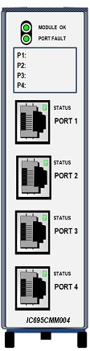
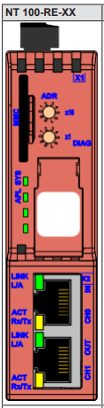
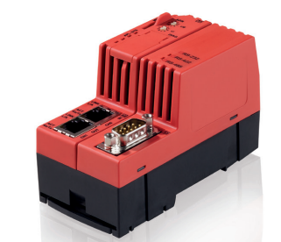
Other Communication Cards
IC695CMM00x may be needed if it is replacing
“Co-Processor”
COMM REQs
Serial Communications
DeviceNet module
IC694DNM200 has been discontinued. Suggested to use a protocol converter and bring in as Profinet.

Slide 11
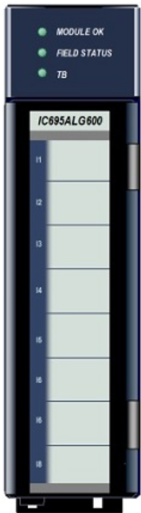
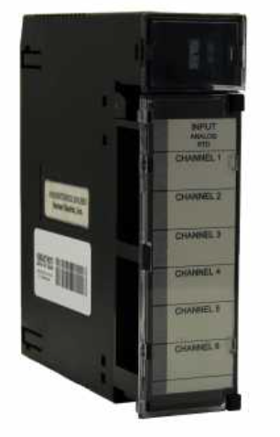
Horner Electric
Horner Electric had RTD and thermocouple modules that were popular. Usually there were 6 channels. Emerson has a few different options.
Option 1.
Easiest, most versatile
IC695ALG600 universal 8 channel input. Non-isolated.
Choose appropriate for sensor type and channels needed.
IC695ALG106 Isolated voltage/current – 6 channel
IC695ALG112 Isolated voltage/current – 12 channel
IC695ALG608 RTD 2/3/4 wire – 8 channel
IC695ALG508 Isolated RTD 2/3/4 wire – 8 channel
IC695ALG312 TC Input J/K/T/E/R/S/B/N/C – 12 channel
IC695ALG412 Isolated TC Input J/K/T/E/R/S/B/N/C – 12 channel
Option 2.
modules specific for TC or RTDs…

Slide 12
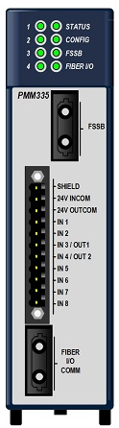
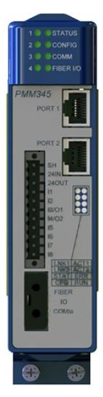
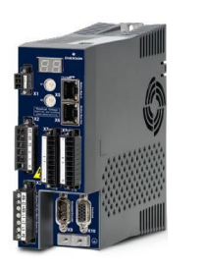
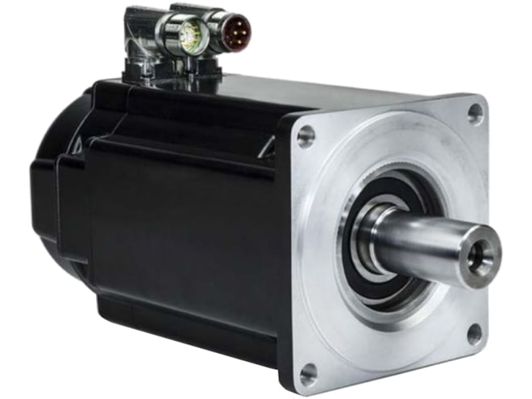

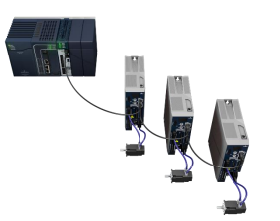
Motion Modules
IC693DSM3xx - Servo module. Worked with GE Fanuc proprietary protocol.
Option 1.
IC695PMM335
Must be installed in an RX3i rack. Serial remote racks are not supported. Old servo drive and motor can be used with IC695PMM335.
1.
2.
3.
IC695PMM345 Motion Module w/ EtherCAT
Servo drive “IC830…”
PACMotion PSR motors. “IC830M…”
Option 2.
Complete New Motion HW
IC695PMM345
EtherCAT protocol is an industry standard and other manufacturers drives and motors may be used.

Slide 13
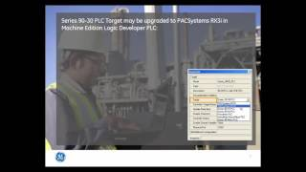
Migration
Helpful Links
https://www.instrumart.com/pages/529/ge-fanuc-9030-conversion-to-rx3i-reference
https://www.instrumart.com/assets/GFK-2722A.pdf
Share the customer project and documentation with Emerson. Emerson is here to help us get it right.
Include Emerson in customer email strings so everyone is included and nothing is overlooked. This also shows we are all collaborating in the best interest of the customer.
Make sure to offer the newest version of PACMachine Edition
Clearly highlight differences when substituting IO and communication modules

